Slide 1


M.Tech/MCAProgram
Advanced Industry Integrated Programs
Jointly offered by University and LTIMindTree
Review III
Customer Churn Prediction & Retention System
Bhavyam Ramani
D003
Knowledge partner | Implementation partner

Slide 2
Project Title - Calibri body 18
Introduction
Customer churn refers to the loss of clients or subscribers from a business's customer base. This phenomenon poses a significant financial challenge for companies, as acquiring new customers costs between 5 to 25 times more than retaining existing ones. The financial implications of high churn rates extend beyond simple customer replacement costs, leading to revenue losses that can threaten a company's long-term sustainability. Without understanding the timing and underlying reasons behind customer departures, businesses lack the actionable insights necessary to implement targeted retention strategies. This gap between prediction and action leaves companies unable to intervene effectively, even when they know which customers are at risk.

Slide 3
Project Title - Calibri body 18
Problem Statement
Customer churn = loss of clients / subscribers.
Business lose 5-25 times more in acquiring new customers Vs retaining old ones.
Traditional Classification misses timing and actionable insights.
High churn causes revenue loss, need to predict WHEN and WHY customers leave, not just WHO leaves.
Existing churn models often only give Yes / No churn outputs.
Business lack actionable insights to retain customers.

Slide 4
Project Title - Calibri body 18
Project Objectives
Predict churn probability (Yes/No) using ML classification models.
Identify Top-5 churn reasons per customer with feature attribution.
Estimate Customer Lifetime Value (CLV) from survival probabilities.
Provide personalized retention recommendations.
Enable customer segmentation.
Build an interactive UI for churn risk, reasons, and retention strategies.
Ensure scalable, reproducible deployment with MLOps.

Slide 5
Project Title - Calibri body 18
Scope of Work
Collect and preprocess customer churn dataset (Telco).
Perform EDA and Feature Engineering to identify churn patterns.
Train ML classification models (Logistic Regression, Random Forest, XGBoost) for churn Yes/No prediction.
Implement survival models (Kaplan-Meier, Cox PH, DeepSurv) for time-to-churn prediction.
Generate personalized churn explanations (Top-5 reasons per customer using SHAP).
Perform customer segmentation with clustering based on survival curves.
Design retention strategies aligned with churn reasons.
Deploy system with MLOps (DVC, MLflow, Docker, CI/CD, Monitoring).

Slide 6
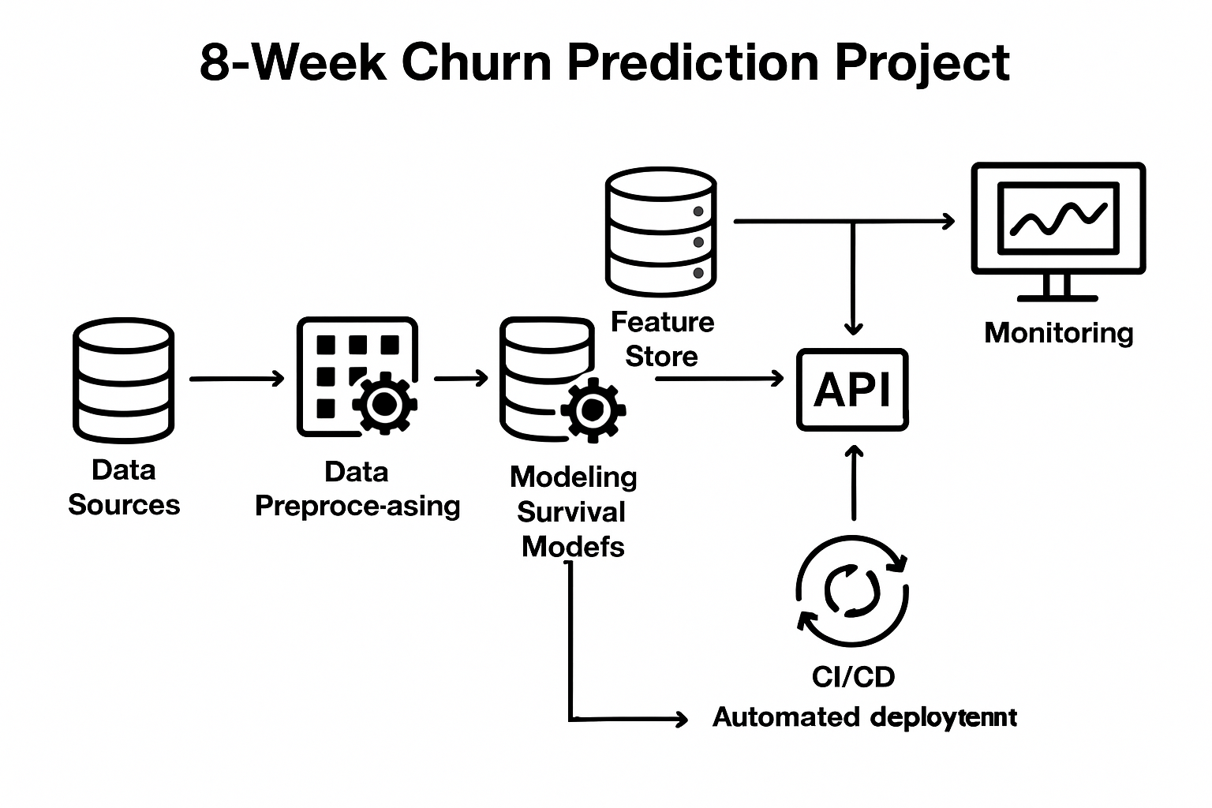
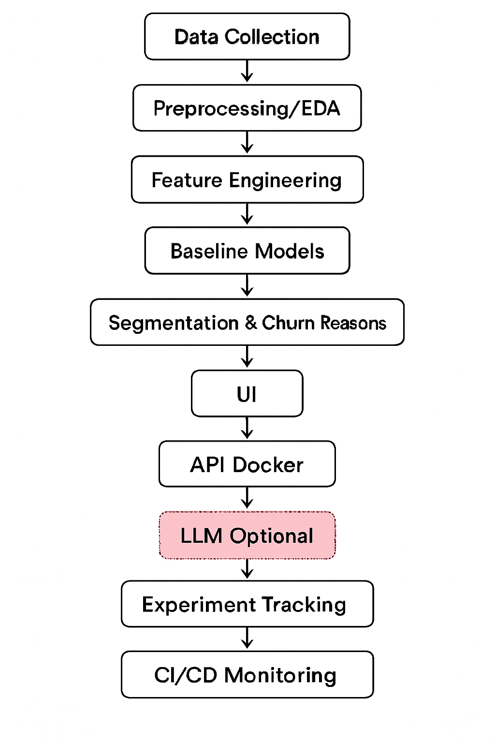
Project Title - Calibri body 18
Methodology / Model Plan

Slide 7
Project Timeline And Tasks
Week 1: Data Collection, Requirement Analysis & Versioning Setup (DVC/MLflow)
Week 2: Data Preprocessing, EDA & Feature Engineering
Week 3: BASELINE MODELS + Kaplan-Meier + Cox Proportional Hazards Implementation
Week 4: DeepSurv Implementation & Hyperparameter Tuning
Week 7: Experiment Tracking (MLflow/W&B) + Model Registry Setup
Week 5: Top 5 Churn Reasons, Customer Segmentation & Retention Strategy
Week 6: UI Development (Streamlit) + API (FastAPI/Flask) + Dockerization
Week 8: CI/CD Integration, Cloud Deployment, Monitoring & Final Report

Slide 8
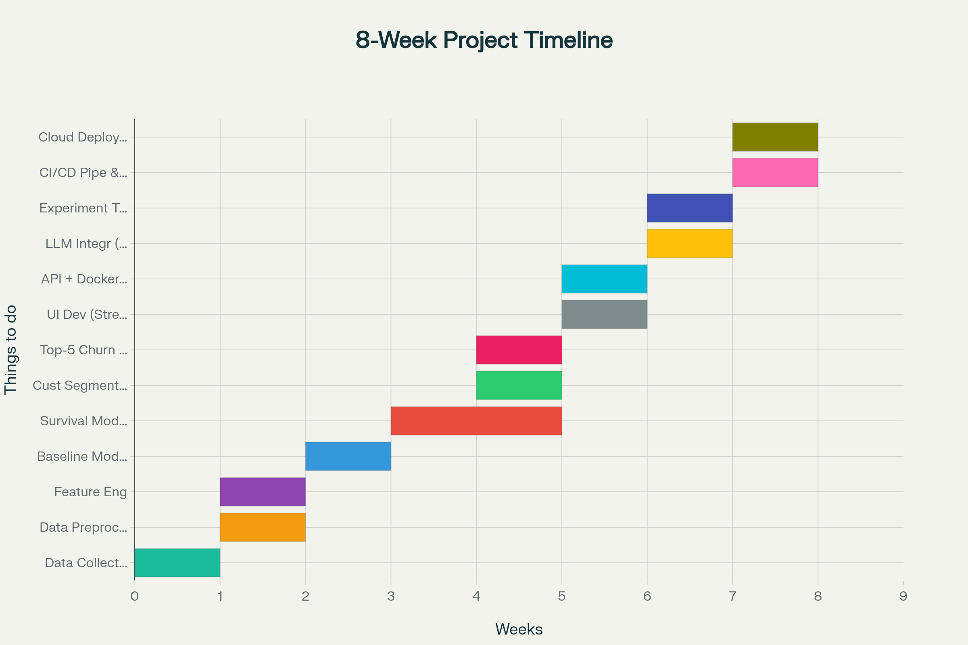

Slide 9
Project Title - Calibri body 18
Approach/Algorithms/Tools
Category Programming AI / ML Visualization Experiment Tracking Web Interface (UI) Deployment | Tools / Tech Stack Python, Jupyter Notebook, FastAPI, Streamlit Scikit‑learn; XGBoost; LightGBM,Logistic Regression (Kaplan–Meier, Cox PH), PySurvival; PyTorch (DeepSurv) Matplotlib, Seaborn, Plotly, SHAP, PowerBI MLflow / Weights & Biases Streamlit (frontend); FastAPI (backend API) Docker, GitHub Actions (CI/CD), AWS / GCP / Azure Cloud

Slide 10
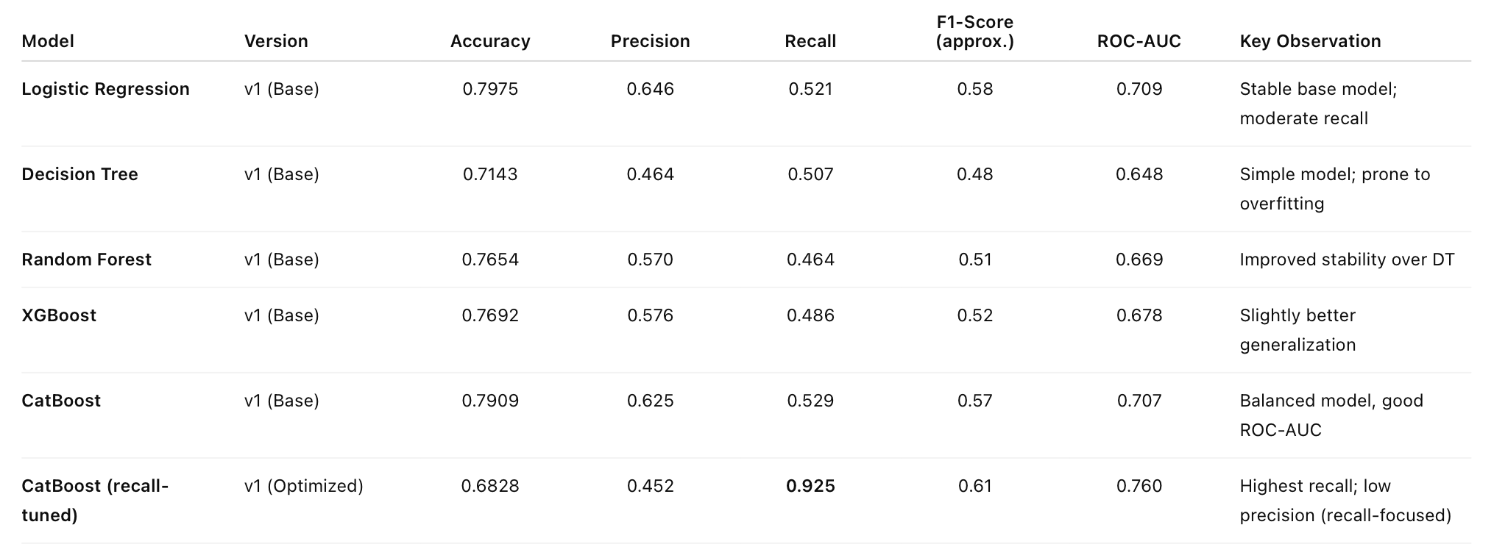
Project Title - Calibri body 18
Findings and Results

Slide 11
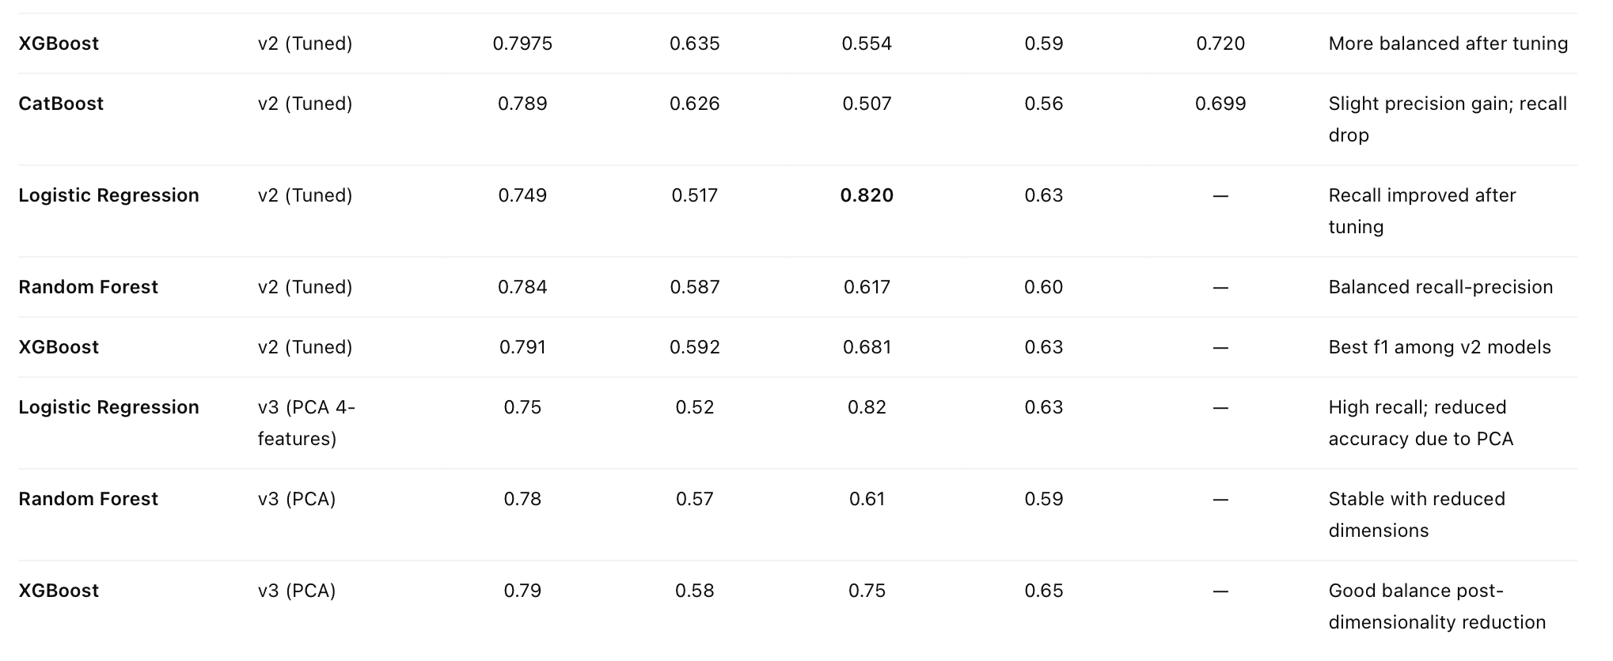
Project Title - Calibri body 18
Findings and Results

Slide 12
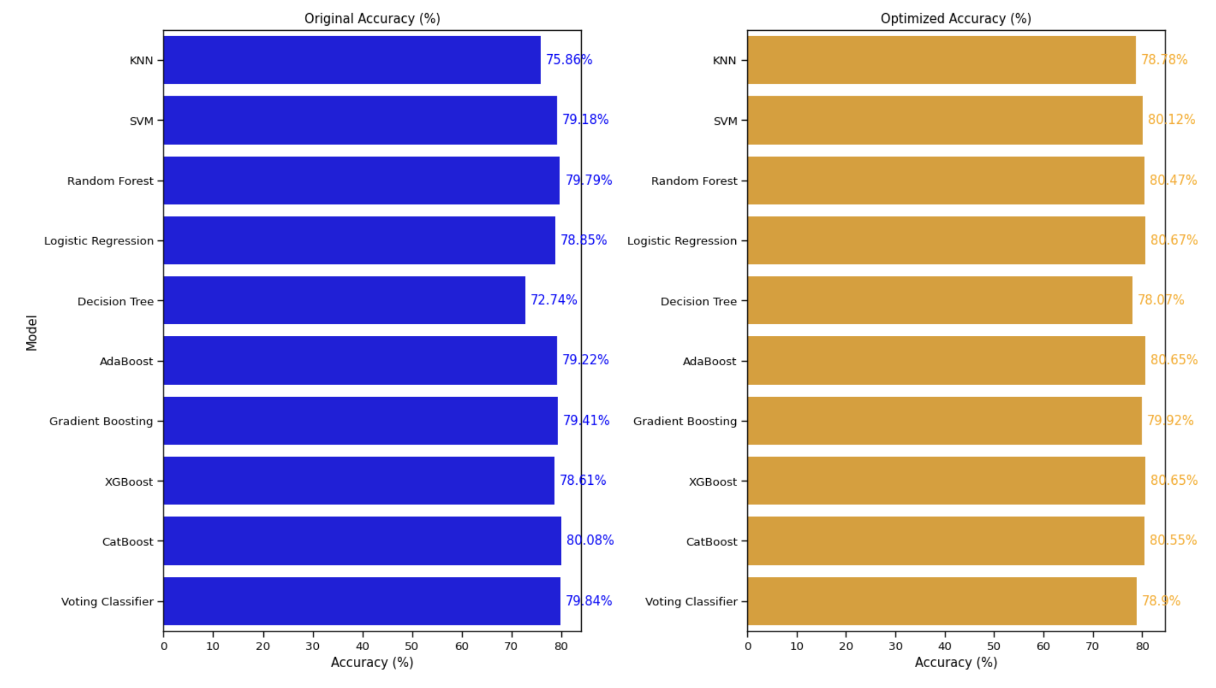
Project Title - Calibri body 18
Findings and Results

Slide 13
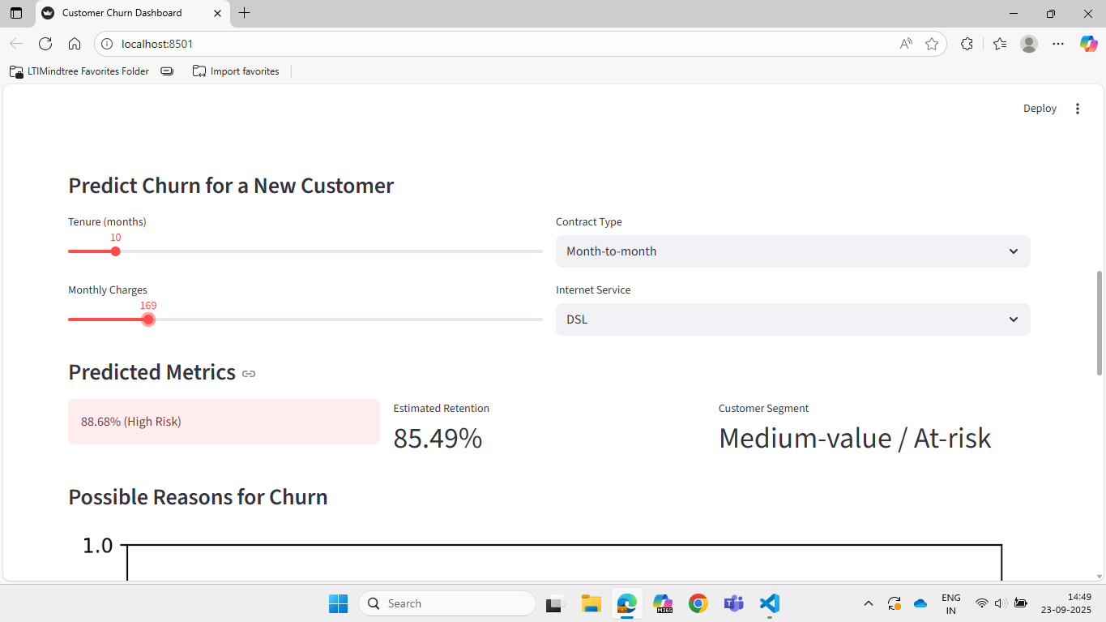
Project Title - Calibri body 18
Findings and Results

Slide 14
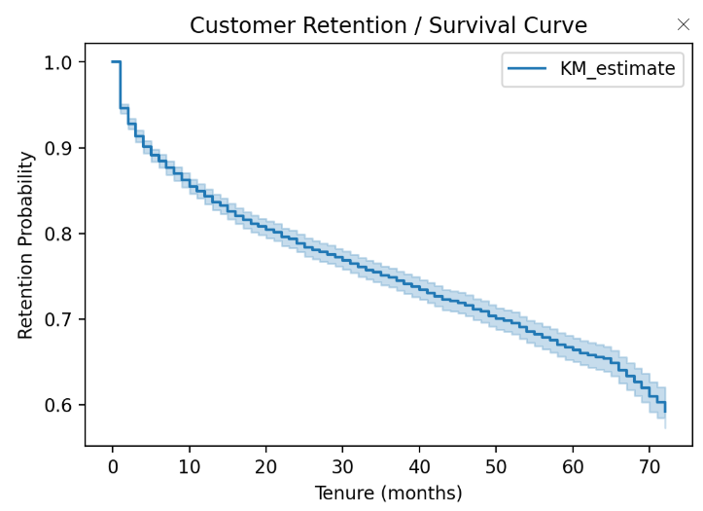
Project Title - Calibri body 18
Findings and Results

Slide 15
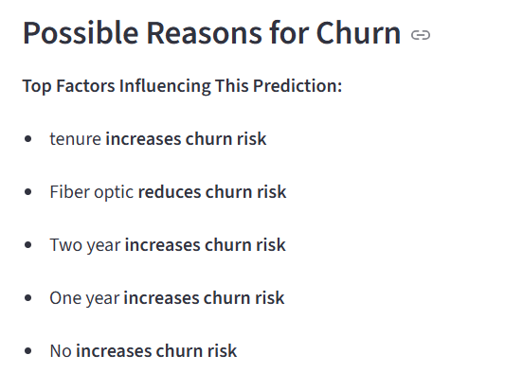
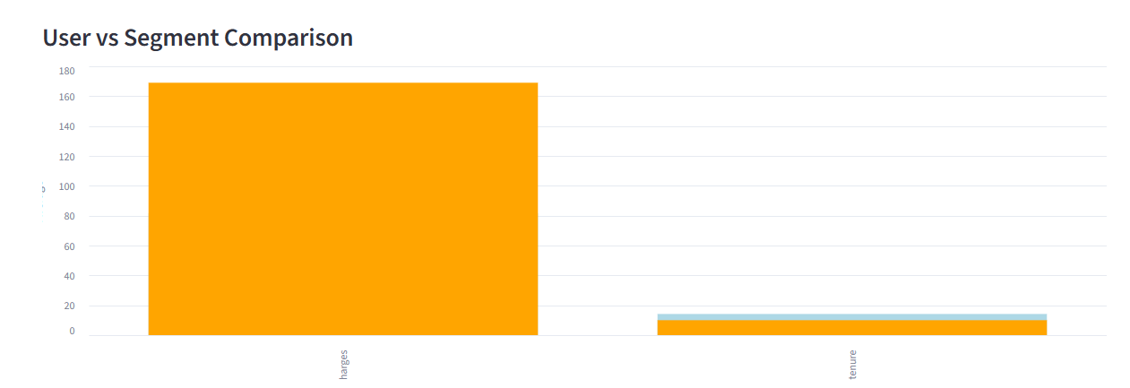
Project Title - Calibri body 18
Findings and Results

Slide 16
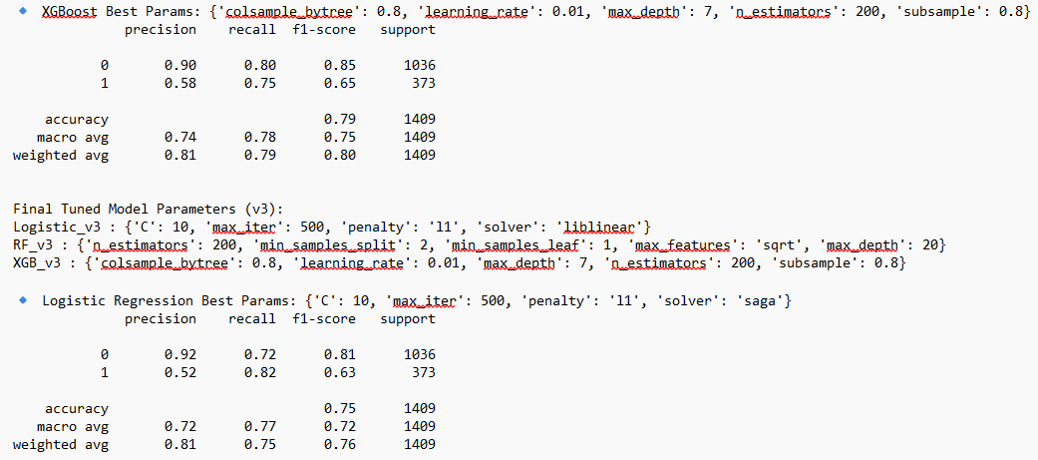
Project Title - Calibri body 18
Findings and Results

Slide 17
Project Title - Calibri body 18
Findings and Results
Logistic Regression (v2/v3) achieved best recall (~82%), critical for identifying churned customers and an accuracy of 75%.
CatBoost (recall-optimized v1) reached maximum recall (92%) but with low precision (0.45) & accuracy (0.68), meaning more false positives.
XGBoost (v3) offered the best trade-off between recall (0.75) and accuracy (0.79).
PCA-based models reduced feature count from 15 → 4, giving faster inference and simpler UI integration.
Decision Tree and Random Forest provided consistent but less recall-focused outcomes.

Slide 18
Project Title - Calibri body 18
Conclusion
Developed a Customer Churn Prediction System using multiple ML algorithms (Logistic Regression, Random Forest, XGBoost, CatBoost).
Optimized recall using feature engineering, GridSearchCV, and PCA-based dimensionality reduction.
Integrated SHAP analysis to explain churn reasons to users directly in the interface.
Performed customer segmentation and bar plot analysis for visual understanding of churn patterns.
Used Logistic Regression (PCA – 4 features) as the final model for deployment — balancing high recall and fast inference.

Slide 19
Project Title - Calibri body 18
Future Scope
Integrate real-time API-based churn monitoring with live customer dashboards.
Include time-based churn tracking (month-over-month retention trends).
Extend clustering with behavioral + transactional data for deeper insights.
Deploy complete solution as a web or cloud-based dashboard for business use.
Time series Forecasting.

Slide 20
Project Title - Calibri body 18
Strengths
High Recall Model: Logistic Regression achieved 0.82 recall, minimizing missed churners.
Explainable AI: SHAP analysis provides per-user churn reasons, increasing transparency.
Customer Segmentation: Clustering identifies high-risk and loyal customer groups.
Dimensionality Reduction: PCA reduces features to 4, making model lightweight and deployable.
Multiple Models Compared: Evaluated Logistic, Random Forest, XGBoost, and CatBoost to choose the best.
SMOTE for Imbalanced Data: Applied SMOTE oversampling to handle class imbalance.

Slide 21
Project Title - Calibri body 18
Limitations
Lower Accuracy for PCA Model: Reducing features led to accuracy drop to 0.75.
SMOTE Didn’t Significantly Improve Metrics: Even after oversampling, precision/recall trade-offs remained.
Limited Real-Time Deployment: Current setup is mostly offline, not live with streaming data.
Feature Dependency: Model depends heavily on structured features; unstructured data not fully utilized.
Simplified Clustering: K-Means may miss complex behavioral patterns; advanced clustering methods could improve insights.

Slide 22
Project Title - Calibri body 18
Acknowledgement
I would like to express my sincere gratitude to Mr. Kiran and Mr. Iftekar, for their continuous guidance, support, and valuable feedback throughout the project. LTIMindtree Mahape Office, for providing the necessary resources and a collaborative environment to carry out this work. My peers and mentors, for their insightful discussions, constant motivation, and encouragement. Lastly, I would like to thank everyone who directly or indirectly contributed to the successful completion of this project. This project has been an enriching experience that deepened my understanding of machine learning, model interpretability, and customer behavior analytics.

Slide 23
Project Title - Calibri body 18
References
[1] Katzman, J. L., Shaham, U., Cloninger, A., Bates, J., Jiang, T., & Kluger, Y. (2018). DeepSurv: personalized treatment recommender system using a Cox proportional hazards deep neural network. *BMC Medical Research Methodology*, 18(1), 24.
[2] Barbiero, P., Norgeot, B., Ayers, J., & Ré, C. (2021). Survival-based predictive analytics for customer churn. *arXiv preprint*.
[3] Lundberg, S. M., & Lee, S. I. (2017). A unified approach to interpreting model predictions. *Advances in Neural Information Processing Systems*, 30.
[4] Chamberlain, B. P., Cardoso, Â., Liu, C. H., Pagliari, R., & Deisenroth, M. P. (2017). Customer lifetime value prediction using embeddings. *Proceedings of the 23rd ACM SIGKDD International Conference on Knowledge Discovery and Data Mining*.
Industry sources: Netflix, AXA, Swiss Re, Allkenso, Pfizer
Data Source: https://www.kaggle.com/datasets/blastchar/telco-customer-churn

Slide 24
THANKYOU

